Slide 1

Indian institute of technology bombay
Ctara
(technology and development)
Final Presentation
on
Evaluation of UAV-based high resolution and
satellite based medium resolution canopy images with
ground based LAI for citrus crop stress
h
by
j
Rahul Raj (143350008)
Project Guide
Prof. J. Adinarayana, CSRE

Slide 2

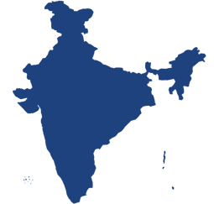

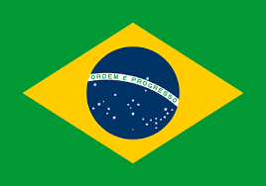

Problem Identification
Citrus fruit industry: Third largest fruit industry of India (Source: NHB)
846000 ha land under citrus crop cultivation in India (Source: Department of Agriculture, GOI)
Issue ???
Image Source: http://www.imgoz.com/ Image Source: Worldatlus
Average
Yield
8.8 tons / Ha
22-35 tons / Ha
Image source: UNDP
Image Source: http://www.mapsofworld.com/
Source: agricoop.nic.in: Department of Agriculturecooperation, and farmers welfare, India

Slide 3
Problem Identification
Reasons of Low Yield
Soil fertility / Nutrients requirement temperature aberration
Pest/Disease Limitations with traditional knowledge of citrus cultivation
Lack of Advance technology Water stress etc. etc. etc.
Mostly due to
Disease like Gummosis, Water stress, lack of advance technology and limitations of traditional knowledge and other biotic & abiotic pressure
Which is result of
Unscientific Farm Management
(unable to understand relations between various factors)

Slide 4
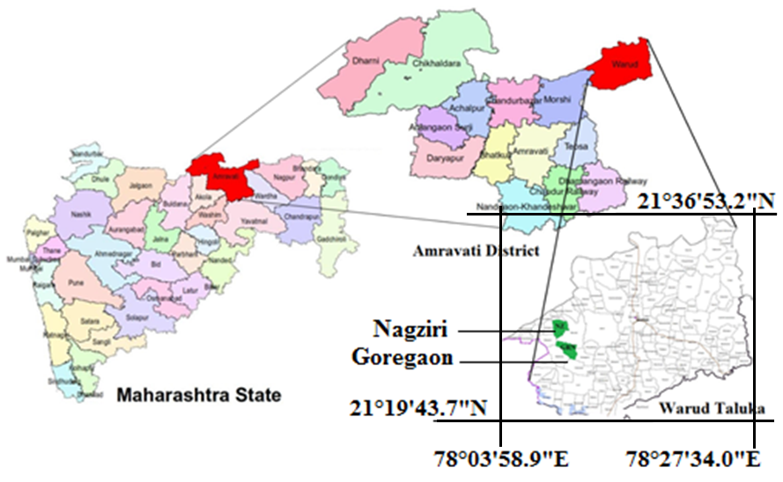
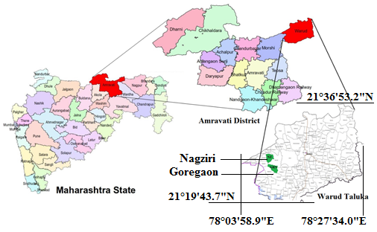
The Study Area

Slide 5
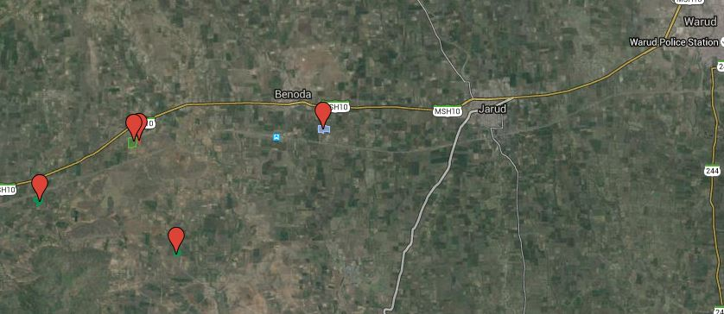
The Study Area
Village Name | Benoda | Goregaon | Bargaon | Nagziri
Geo location of test site | 21º27’4’’N 78º11’23’’E | 21º25’41’’N 78º9’38’’E | 21º26’16’’N 78º8’0’’E | 21º26’55’’N 78º 9’9’’E
Area majorly affected by Gummosis and Fruit drop.
Other identifiable disease are Root-rot, fruit splitting, fruit canker.
8.5 km
Warud
Nagziri
4.7 km
2.5 km
Benoda
2.5 km
Bargaon
Goregaon

Slide 6
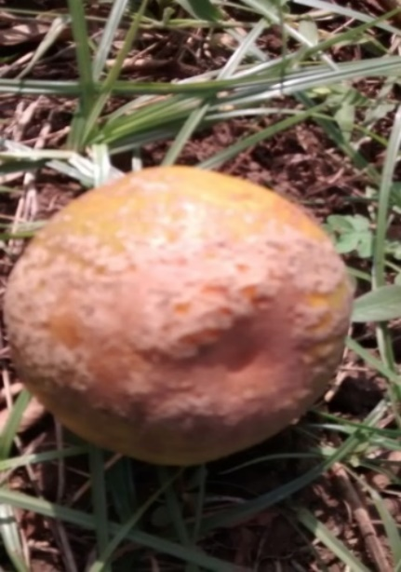
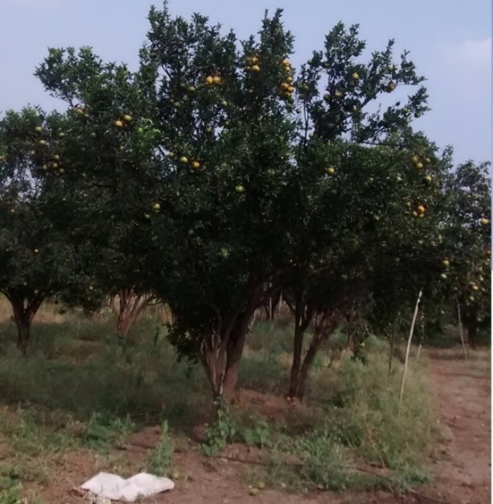
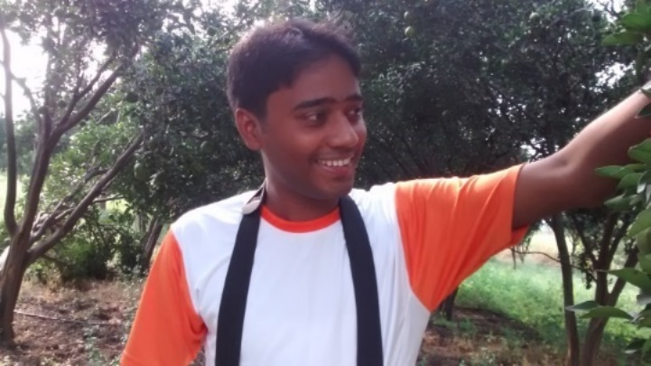
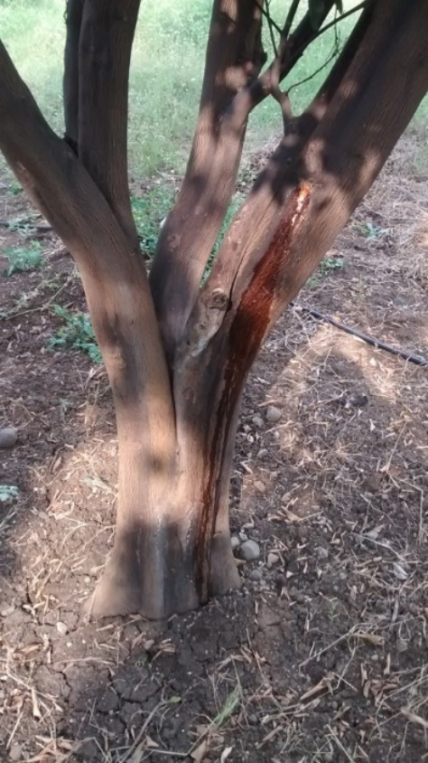
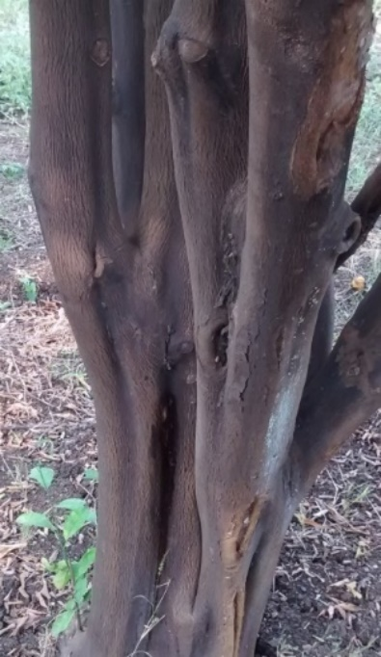
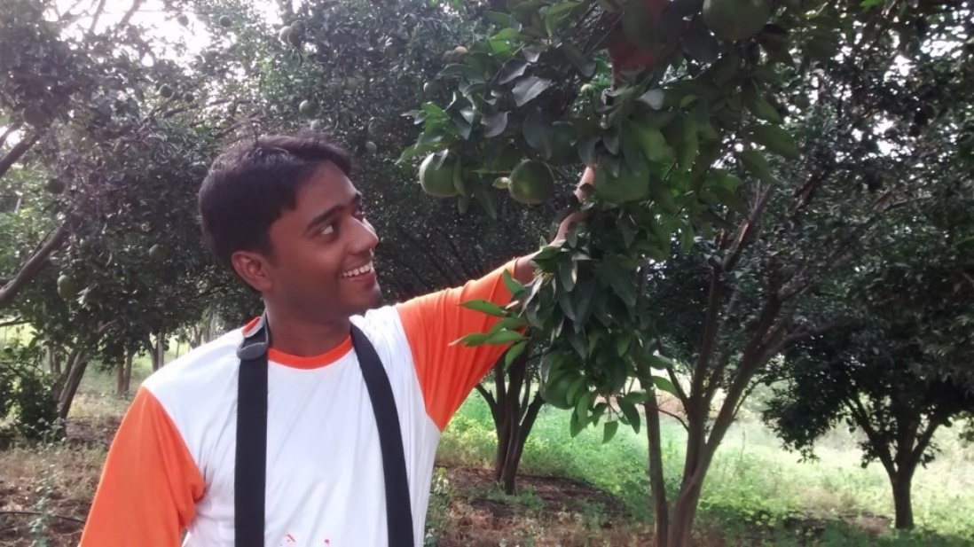
The Study Area
Fruit Canker
Root-rot
Gummosis

Slide 7
Platform Selection
Sub-meter resolution satellite image | Drone based high resolution image
Cloud cover and atmospheric dust particles create bottleneck on quality of imaging | NO effect of cloud cover or atmospheric dust particles on captured images
Getting images for civilian purpose takes at least 1 week. | Images can be obtained in hours depending on size of the farm.
Images captured at some fixed time of day depending on frequency of revolution of satellite. | Images can be captured at desired time of day.
Maximum available Panchromatic geometrical resolution is 30 cm while Multispectral resolution would be 1.24m. | Geometrical resolution may go around 1 cm.
Minimum area map which can be ordered is 25 square km or more. (if only natural colour map required then 10 square km) | Map can be generated for small targeted area which would be much cheaper than satellite imaging.
Images generally taken with angle making 0 degree with vertical. | Images at different angle can be taken which will help in getting architectural information of Orchards.
Source1: http://www.landinfo.com/satellite-imagery-pricing.html
Source2: http://www.satimagingcorp.com/satellite-sensors/geoeye-2/
Source3: only natural colour map: http://cms.mapmart.com/Products/SatelliteImagery/AvailableImmediately.aspx
Source3: http://rami-benchmark.jrc.ec.europa.eu/

Slide 8

Selection of Drone
Sr. No | Fixed Wing | Multi Rotor
1 | Needs direct human handling for taking off | No need of direct human handling for taking off
2 | Requires landing stripe for safe landing | Can land in small area, No need of landing stripe
3 | Unstable in windy condition | Relatively more stable in windy condition
4 | Can’t be stopped during flight | Can be stopped during flight
5 | Flight speed is relatively high and thus can cover more distance in same time | Flight speed is relatively low
6 | Can’t take sharp turns during flight | Can take sharp turns during flight
Quad-copter is selected
300 gram payload: 15 mints flight time
Collaboration with “DronaAviation”

Slide 9
Process flow Diagram
Digital image collection using UAV platform
Google images
High density LAI meter data collection using LAI meter
Image Stitching and geo-tagging to make orthomosaic
Determination of LAI from gap fraction
Comparison of UAV, Google and LAI meter data
Identification of the equation which correlates between two LAI values taken from drone and LAI meter

Slide 10
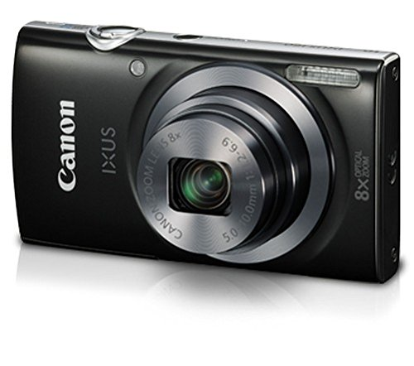
Selection of Camera
16 MP programmable camera
Focus at infinity
Programmed to capture images at every 3 seconds
Digital Point and Shoot Camera

Slide 11
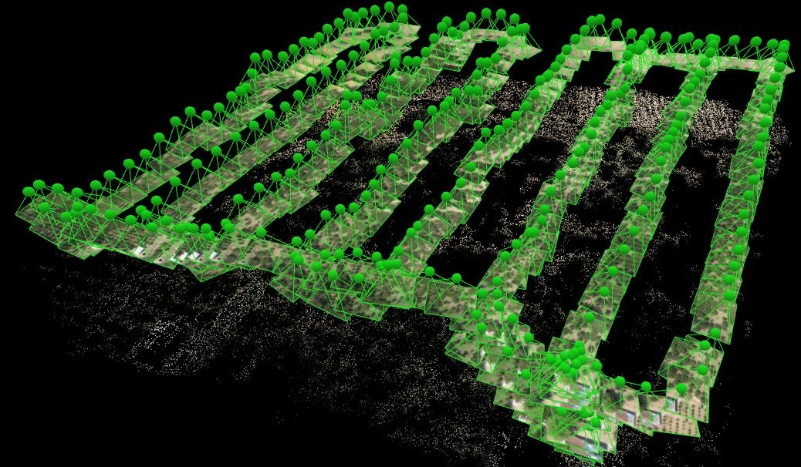
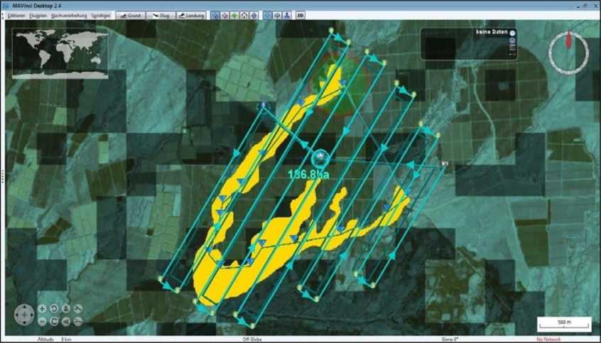
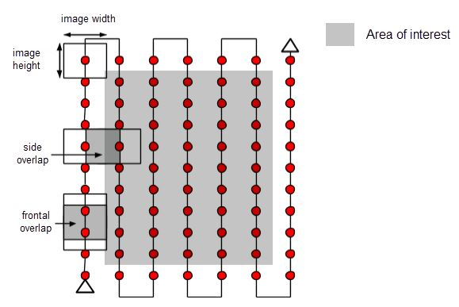
Image Capturing Technique
Source: http://drones.newamerica.org/
@ 30 m height, image capture speed 1 per 3 sec then UAV speed should be less than 3.4 m/sec (considering FOV 60º)
70 % frontal overlap
50 % side overlap
Source: http://www.mdpi.com/

Slide 12
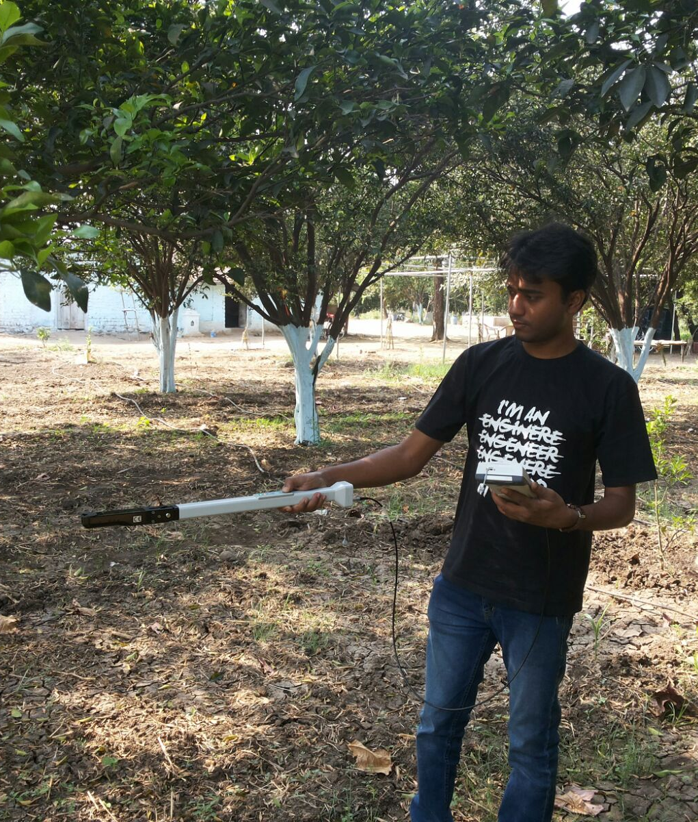
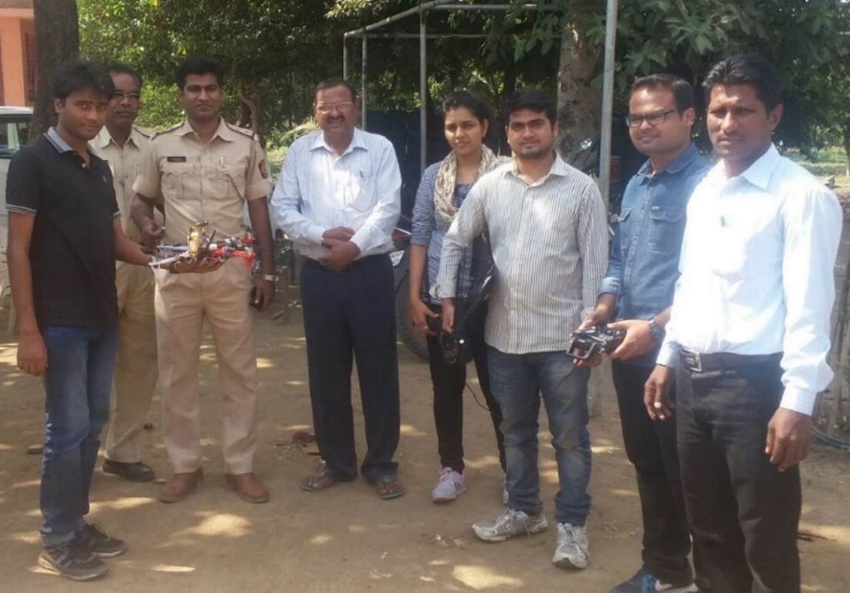
Field implementation
Figure: Field implementation is done after proper permission from Police.
Figure: Using LAI meter in plot of Nagziri

Slide 13
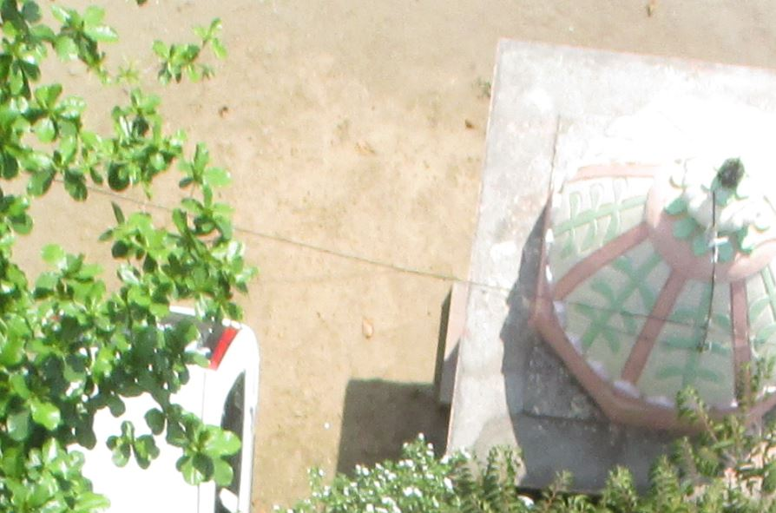
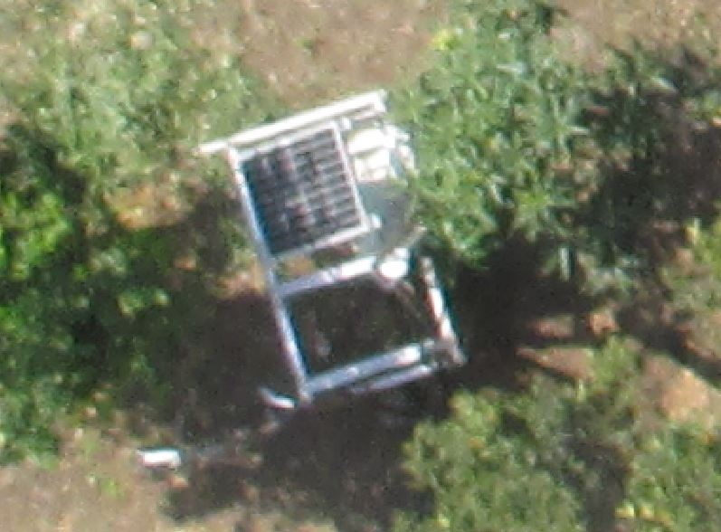
Resolution
Camera FOV is 30° and 24°
Average image size 9 MB
Average pixels per square cm is 3

Slide 14

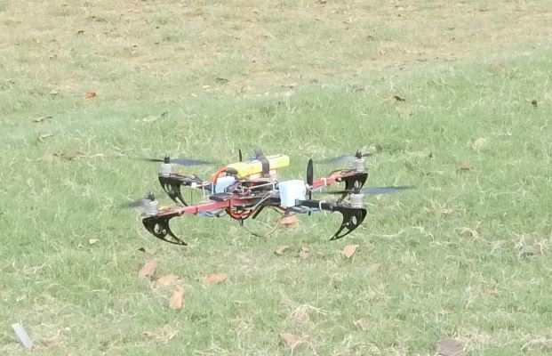

Leaf Area Index
The ratio of leaf surface to soil surface is termed leaf area index
Leaf area is important input parameters in canopy photosynthesis modelling
…….Humboldt University of Berlin
Monitoring distribution and changes of LAI is important for assessing growth and health of vegetation ……Food and Agriculture organisation
Figure: Drone using which images are captured
LAI measurement
LAI meter | Drone based top of the canopy Image
Time consuming and labour intensive method | Time saving and least human labour
LAI Values are highly dependent on handling and position of the LAI meter | Top of canopy images are same for a plot and gives a unique output data after processing
Ignore reading when its B reading becomes more than A (reference) value | Number of pixels with different grayscale levels should be enough to form Gaussian curve
Figure: use of LAI meter in farm
16 MP Digital Point and Shoot programmable camera
Focus at infinity
Programmed to capture images at every 3 seconds

Slide 15
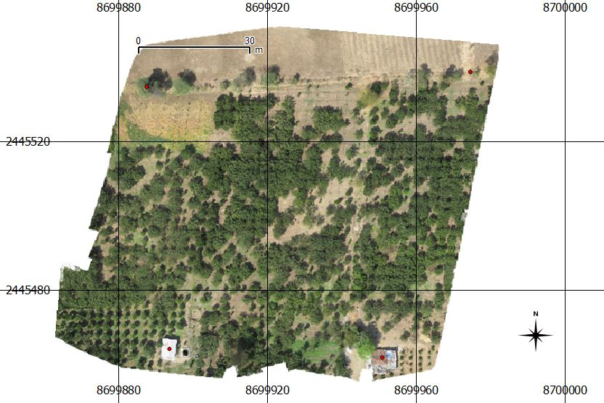
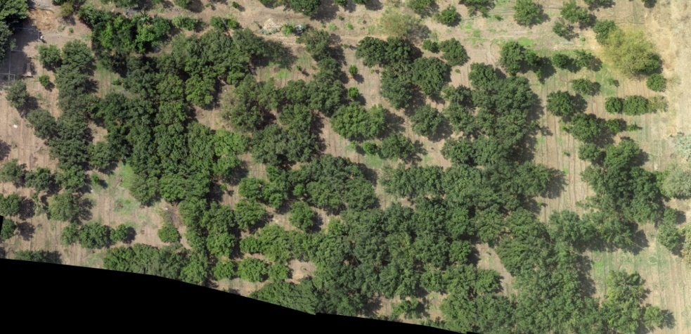
High resolution (3cm * 3cm) citrus farm map
(made from images captured by drone)
LICOR’s LAI 2200 is used to read LAI values in farm by moving in Ro to R22 rows
- - - - - - - - - - - - - - - - - - - - - - - - - - - -
R0 R1 R19 - - - R22
Place: Nagziri, Warud Taluka, Amravati, Maharashtra
Rows extraction from the map
(depending on position of LICOR data)

Slide 16
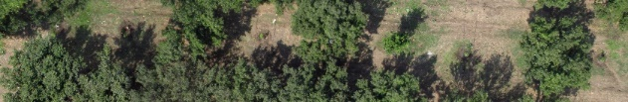
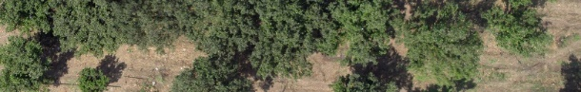
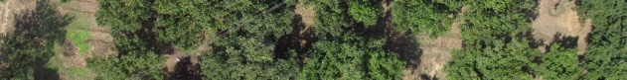
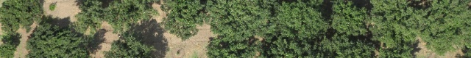
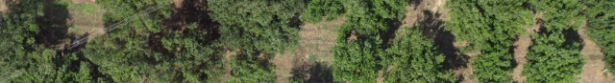
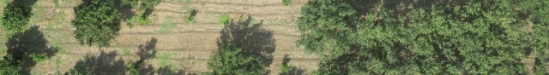
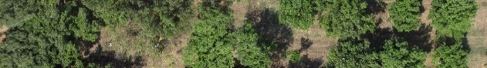
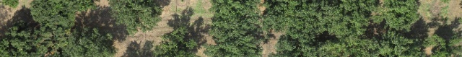
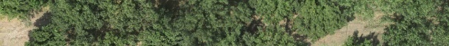
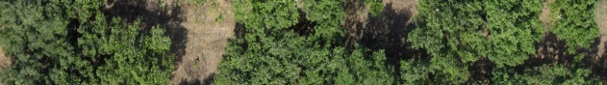
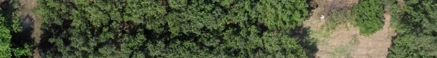
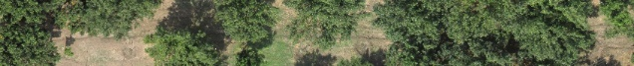
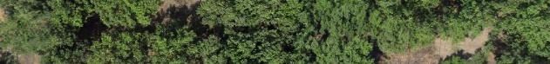
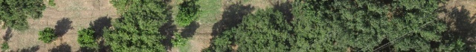
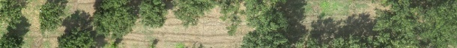
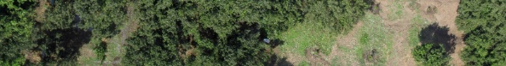
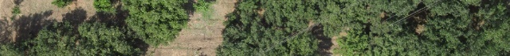
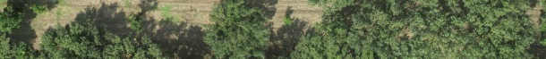
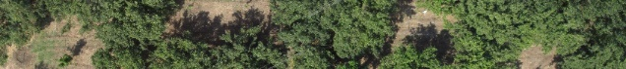
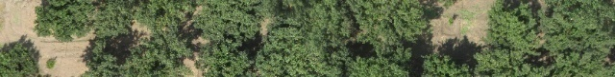
Extracted Rows
Total number of Rows – 23 (20 rows are valid)
In Rows 6, 15 and 22 Licor meter couldn’t read LAI values
06
15
22
Note: Star marked Rows i.e. 06, 15 and 22 are not used

Slide 17
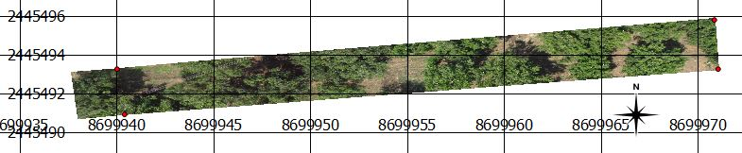
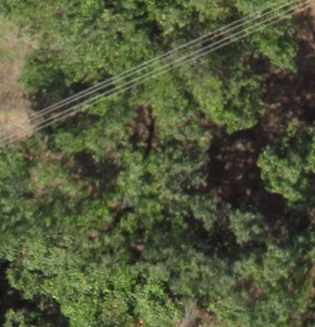
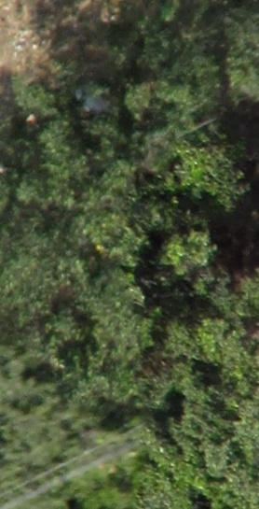
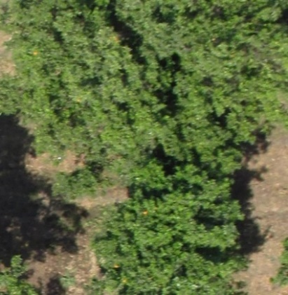
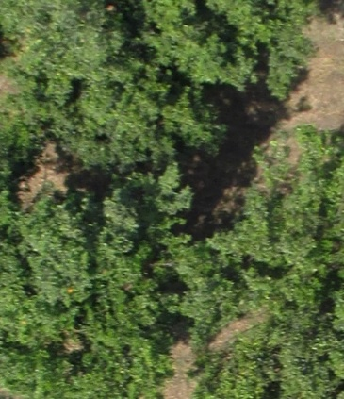
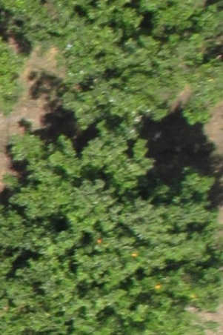
Image Block extraction from the Rows
(depending on position of LICOR data)
Total valid image blocks: 71
Row 7
Image blocks separated from Row 7

Slide 18
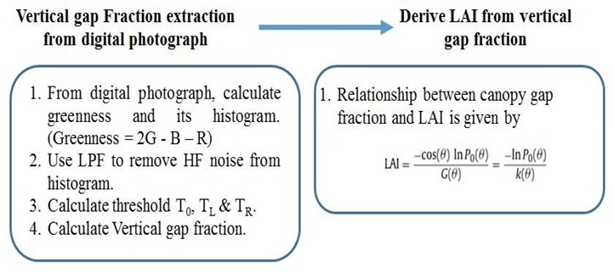
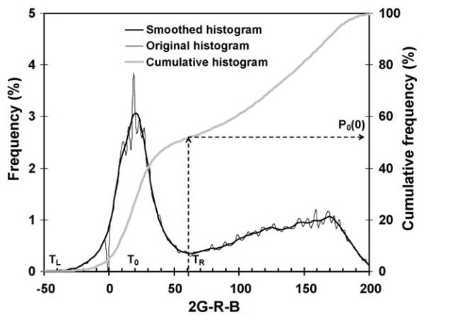

Image Processing
How to get LAI from canopy image
P₀(ϴ) : Gap fraction in view or solar zenith angle ϴ.
G(ϴ) : Foliage projection coefficient for the plane perpendicular to direction ϴ
K(ϴ) : Canopy Extinction Coefficient.
Source: Paper on “Retrieval of leaf area index from top-of-canopy digital photography over agricultural crops’ by J. Liu and E. Pattey.
$$T_{R}$$
is an important point (first minima of curve) as it separates green and non green pixels. Minima is a point whose left and right side values are greater than its own value
Gap fraction is representation of density of green crop canopy. i.e. how much percentage of ground area is not covered with leaves when seen from above the canopy. Higher the gap fraction, lower the green canopy density.

Slide 19





Separate Red, Green and Blue band image
Extraction using MATLAB
Red band image
Blue band image
Green band image
One block from Row 7

Slide 20





Converting Greenness to grayscale image
2G – R - B
Grayscale
Greenness image
Grayscale image of Greenness
Greenness image is colored image and thus have 3 dimensions (Dimensions are X, Y and 3rd dimension shows value of R, G and B)
Grayscale version of Greenness image is having only Row and column as dimension and thus it’s histogram can easily separate number of pixels based on intensity value which is direct separation of green and non green area in the image

Slide 21


Histogram of grayscale image and applying LPF
Low Pass Filter

Slide 22
LAI values of Licor & Gap fraction of images
(Arranged in decreasing order of Licor’s LAI value)
All ‘m’ named columns has LAI values stored from Licor’s LAI meter
All ‘d’ named columns has gap fraction values calculated from digital image
Average is calculated using k = 0.5

Slide 23
Gap fraction of images
Vs
LAI of images
&
LAI of Licor

Slide 24



Slide 25


LPF applied on actual values

Slide 26


Google image based LAI value Vs LAI meter data
Scatter plot
Row | Google map LAI | Licor LAI
0 | 1.099132904 | 1.32
1 | 1.099132904 | 2.66
2 | 1.7512575 | 2.34
3 | 1.831581714 | 2.26
4 | 0.662849991 | 0.79
5 | 0.445037493 | 3.21
11 | 0.464368592 | 2.56
12 | 1.010681387 | 1.58
16 | 8.930816487 | 1.06
18 | 8.930816487 | 1.49
19 | 1.102253841 | 1.49
20 | 0.646204035 | 1.63
21 | 0.646204035 | 1.09
Values are weakly negatively correlated with
LAI values can’t be determined for small areas as no sufficient pixels are available in small area of google map
$R^{2}=−0.$2943

Slide 27


Google image based LAI value Vs Drone data
Scatter plot
Values are weakly correlated with
LAI values can’t be determined for small areas as no sufficient pixels are available in small area of google map
$$R^{2}=0.0983$$

Slide 28
Summary / Conclusion
Drone based method of finding LAI seems promising as the values are strongly correlated with LAI meter values.
Drone based LAI values are more consistent at given location, as in top of the canopy images, visible gap fraction is constant but in case of LAI meter, the visible gap fraction depends on orientation of the LAI stick and can change even for centimeter shift in any direction.
Google map based LAI values are not correlated with any of the other two methods due to its low resolution.

Slide 29
Future scope
Presence of green non-leafy part in top of the canopy image (presence of green grass in canopy background) creates bottleneck in finding actual gap fraction which further results in wrong LAI estimation. Research can be done on removing any non-leafy area from top of the canopy images.
To see effect of different seasons on LAI, such research work should be carried out in other seasons too.
Temporal collection of top of the canopy images can give information about changes in canopy structure over time which can be further correlated with yield estimation.
LAI values can be associated with NDVI values to estimate the level of healthiness of the crop.

Slide 30
THANK YOU

